Slide 1

Group B2
LLM Study Assistant Software
Yuan Moxuan 2130026188
Chen Jiayu 2130026227
Peter Erickson 2330000199
Wei Yiming 2130026149
Wu Yuanrong 2130026161
Wang Yuhao 2130026144

Slide 2

Part 1: Software Engineering
Modeling and theory involved in development of our LLM Assignment Helper

Slide 3
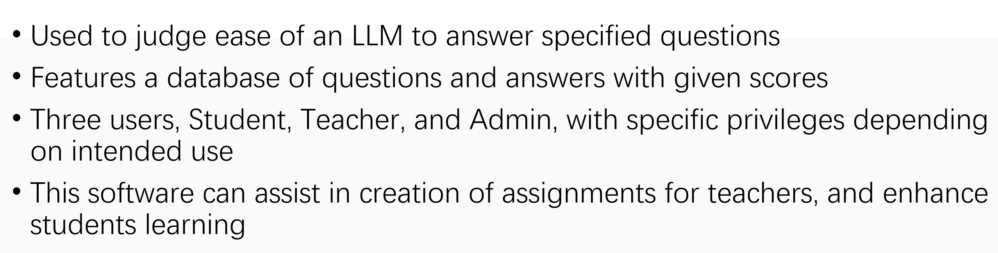
What is this Software

Slide 4
Why should you use this software?
Rich features: The software has a variety of functions to meet the different needs of users.
Efficient performance: The software is optimized for efficient operation and processing.
Reliability: Under load, this software has proven reliable for a variety of users.
Specifically, this software’s main benefits are
Improve productivity
Error and risk reduction
Enhanced Data management
Provide real-time information and immediate feedback
Support collaboration and teamwork
Providing good user experience

Slide 5
How does this software differ from competitors?
Intuitive interface design: The software has an intuitive and simple user interface that allows users to quickly get started
Easy to use: The software provides a simple and clear operation flow, and users can easily complete tasks without a tedious learning process.
Friendly navigation and feedback: The software provides a clear navigation structure and instant feedback to help users find exactly what they need and get timely guidance and tips.
Plentiful documentation and support resources: The software provides detailed documentation and support resources to help users solve problems and understand the functions of the software.

Slide 6
Diagrams
Used many diagrams, will focus on the most important three
Use-Case
Class
System Architecture
Diagrams were important to properly plan, and ensure the requirements were met
By diagramming prior to development, we were able to have a clear view of what was needed in order to develop this application

Slide 7
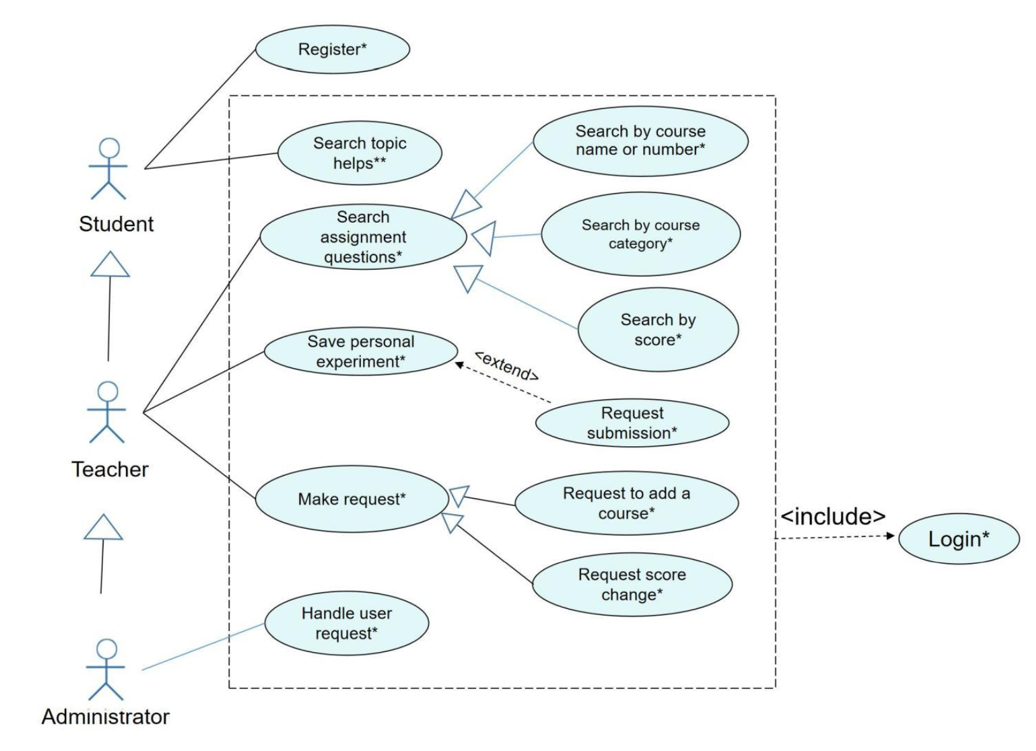
Use-Case Diagram

Slide 8
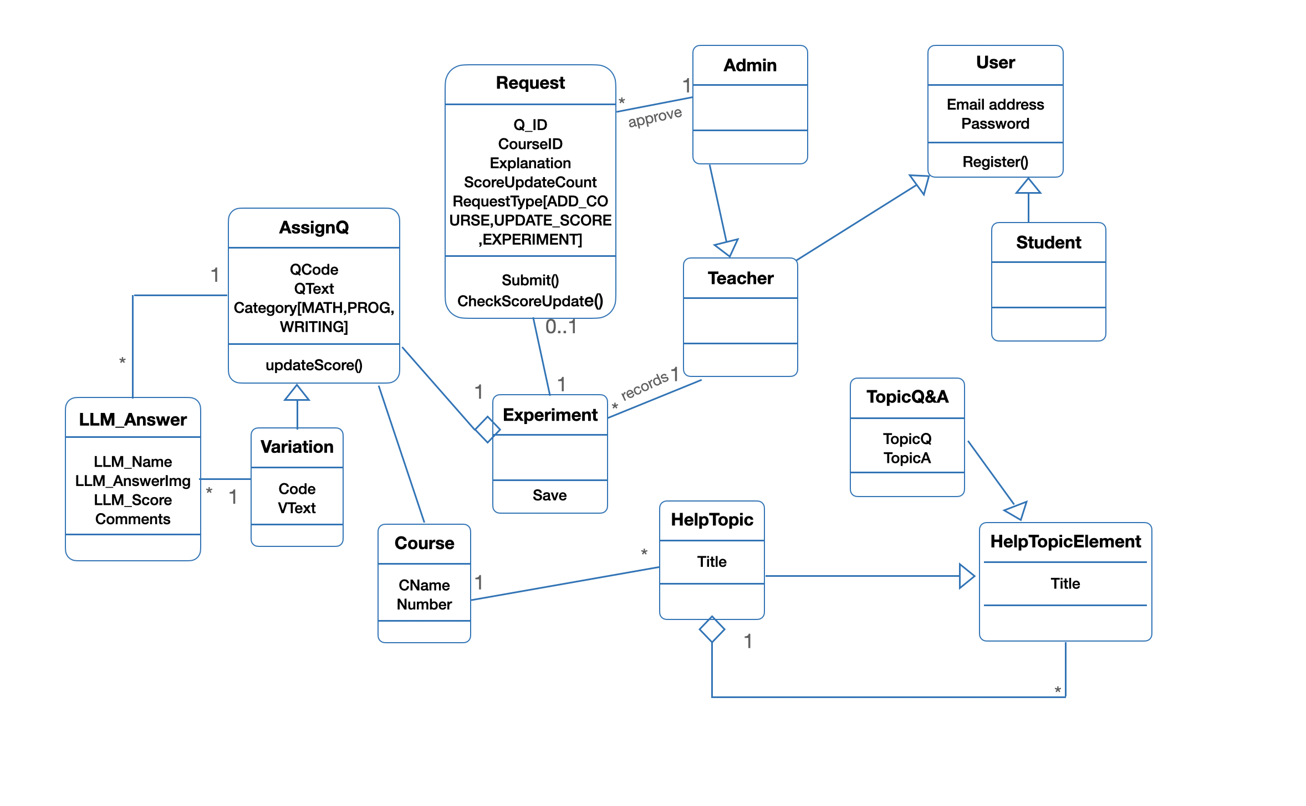
Class Diagram

Slide 9
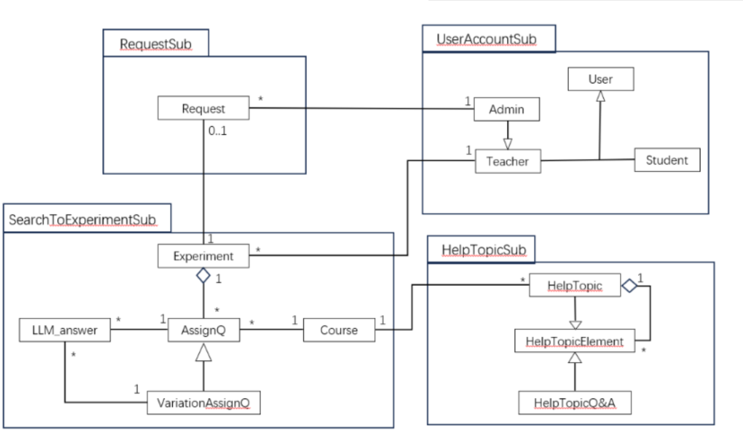
Overall System Architecture
Four main subsystems
Request, UserAccount, SearchToExperiment, & HelpTopic
Division allowed in-depth testing, and efficient collaboration

Slide 10
Part 2: Software Development Workshop
Details, development, coding, and testing utilized in our LLM Assignment Helper

Slide 11
How to Open the Software

Slide 12




To open the software, you need to do some prepare. There are 8 steps.
1. Install a suitable Python editor (We recommend Pycharm, or VSCode)
2. Install a suitable Version of Python (We recommend Python 3.11).
You need to run the follow code in the terminal of your Python Editor: pip install Flask PyMySQL SQLAlchemy Flask-SQLAlchemy
3. Install some libraries.
4. Install xampp (a database software).

Slide 13
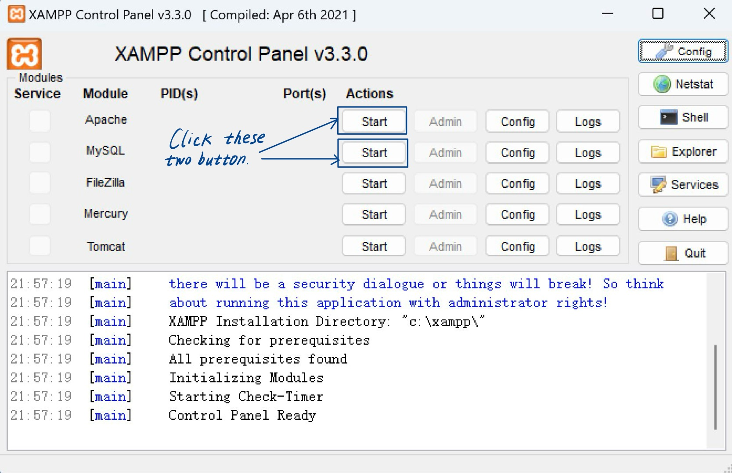
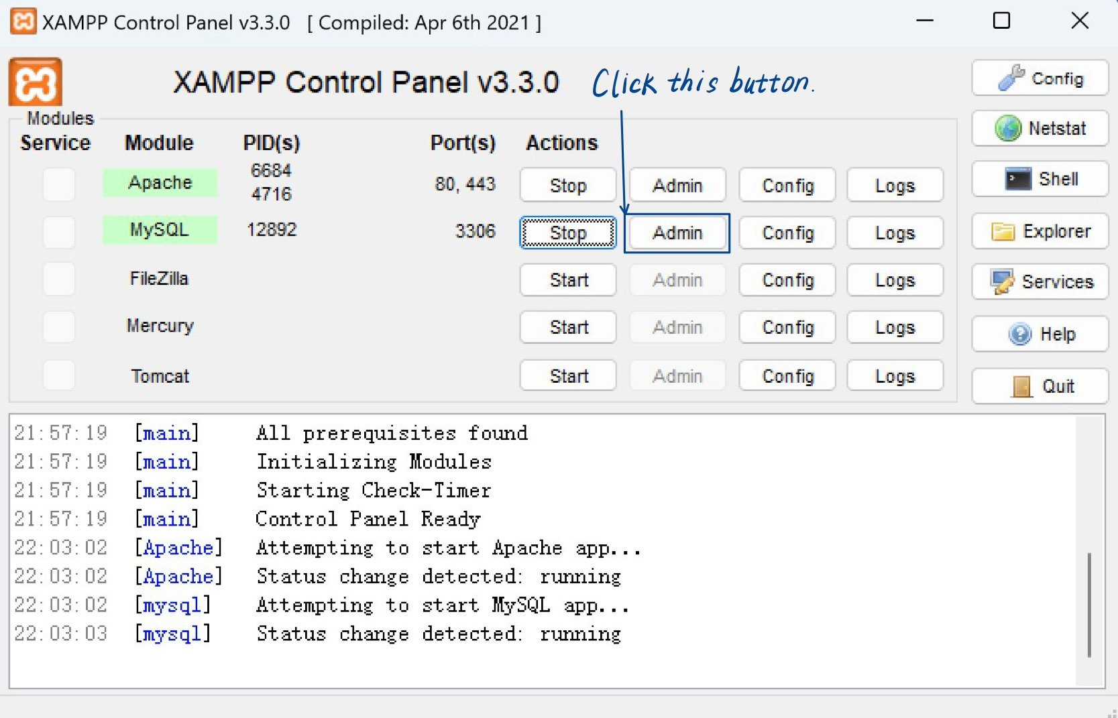
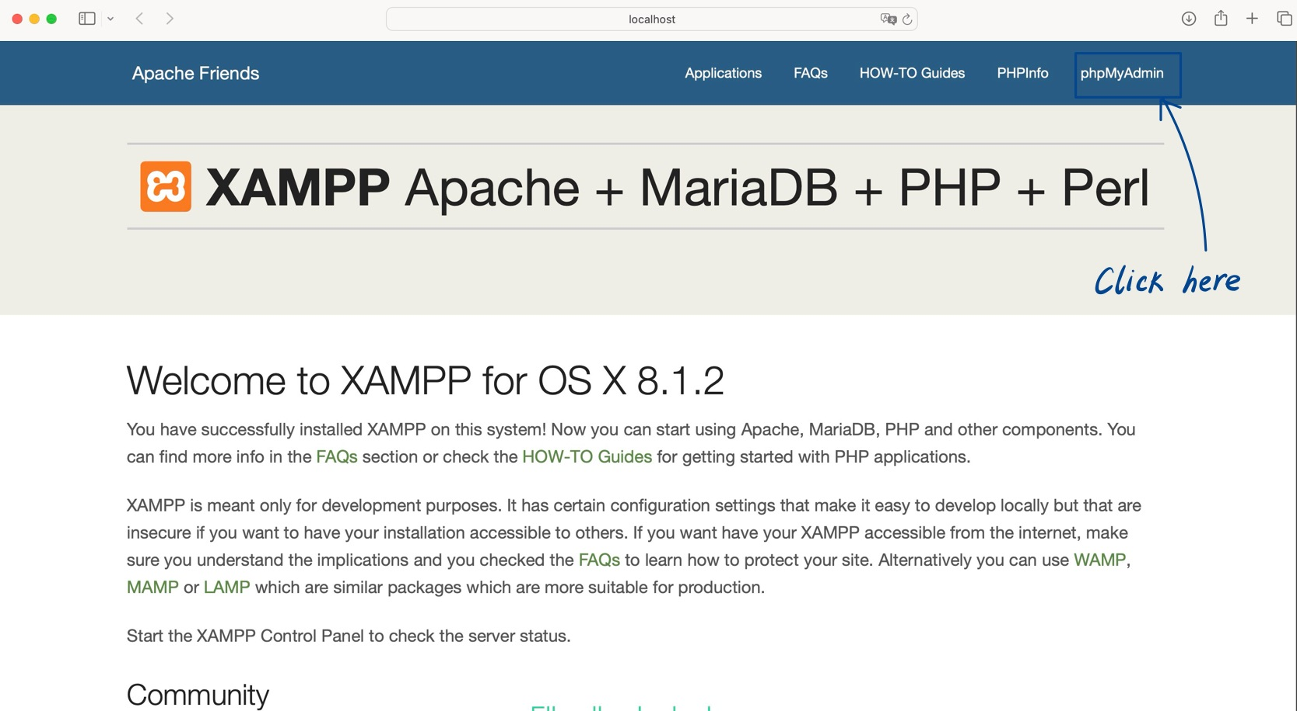
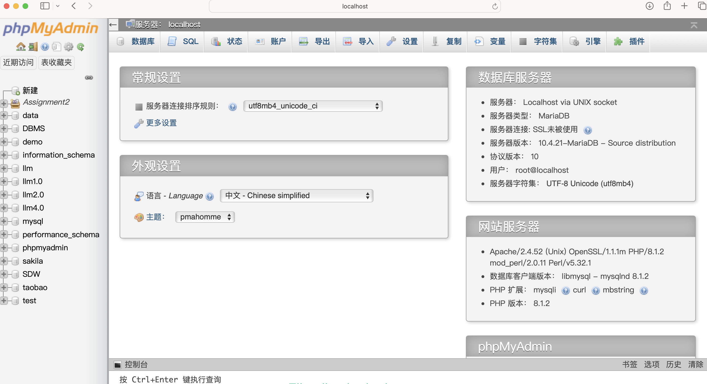
5. Open xampp,
Your browser will automatically open a database web page.
Then create your database.

Slide 14
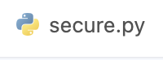
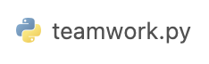
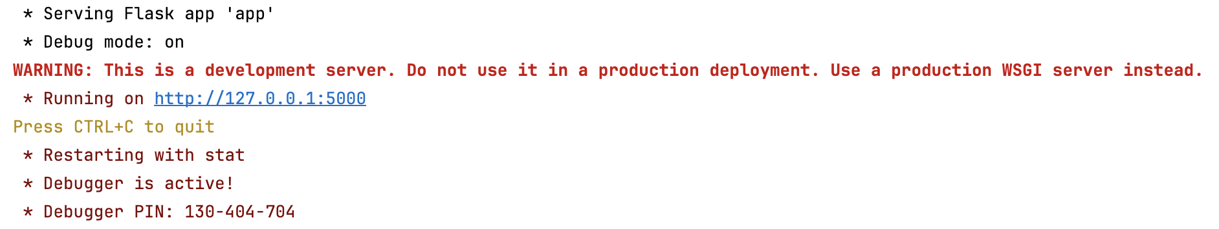
You need to change the blue box in the figure below to the name of the database you created.
6. In this file,
7. You need to run this file in your Python Editor.
If you get this result, it means you ran the software successfully.
8. Put this URL to your browser: http://127.0.0.1:5000/user/login. Then you can start to use the software.

Slide 15
Main Functions

Slide 16
Functions of User - Teacher
As a teacher, after registering and logging in, there are a number of features that you can access
Navigation Bar
Search Bar
Search Results
Question Details
Saving & Submitting For Experimentation
Adding New Courses

Slide 17
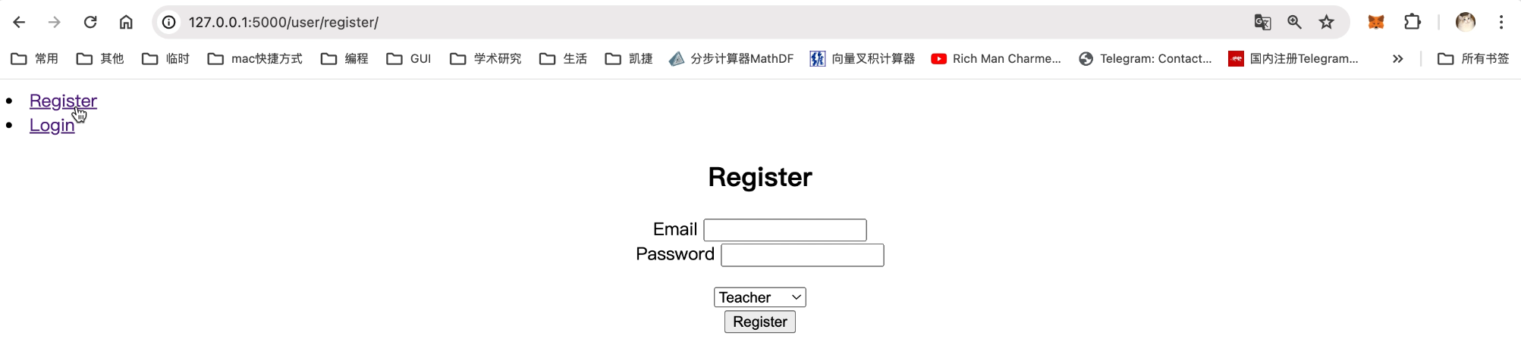
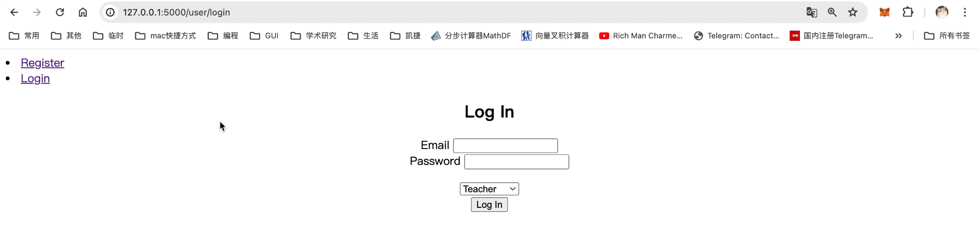
Register:
Input your email and password
(the email address should be ralid; the password is at least six characters long)
Select the correspongding identity
Finally click “redister”
Login:
Input your email and password here.
Select ”Tescher”
Finally click “Log In”

Slide 18
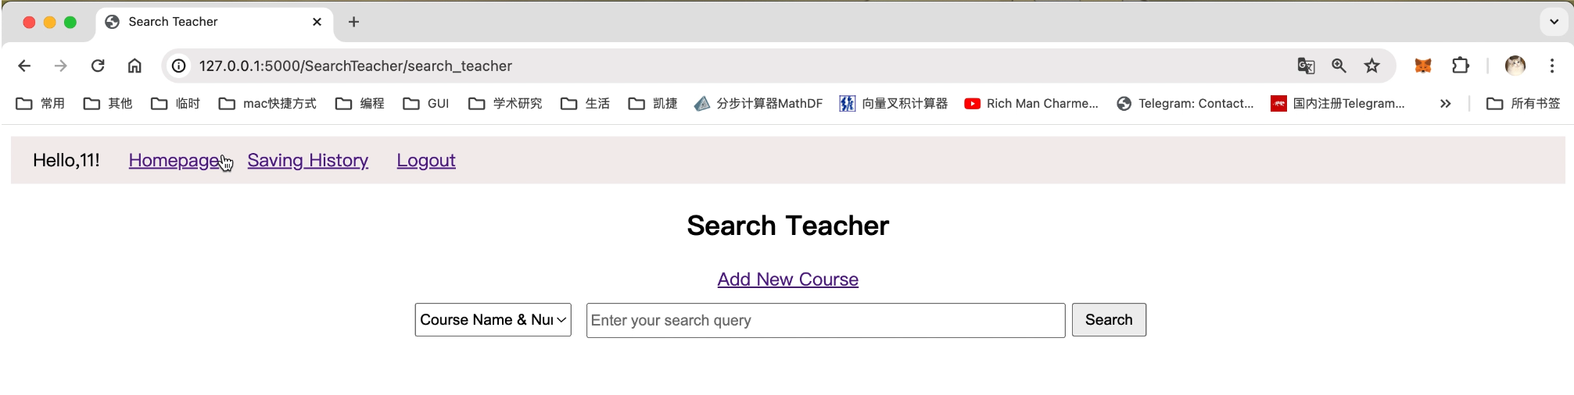
Navigation Bar:
This is logout button
Click here you can add new course
Click here you can go back to search this interface
Click here you can see your saving history

Slide 19
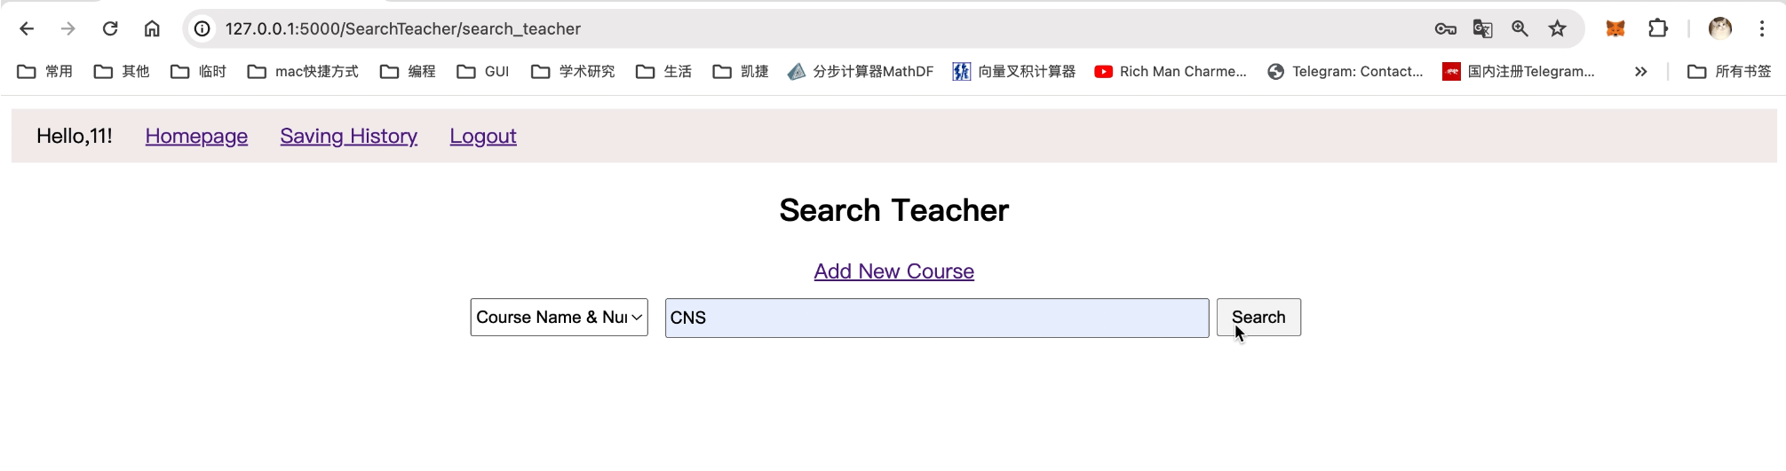
Search Bar:
1.
2.
3.
Choose “Course Name & Topic” or “Category” for different search mode
Input corresponding text for searching
Click “Search” button

Slide 20
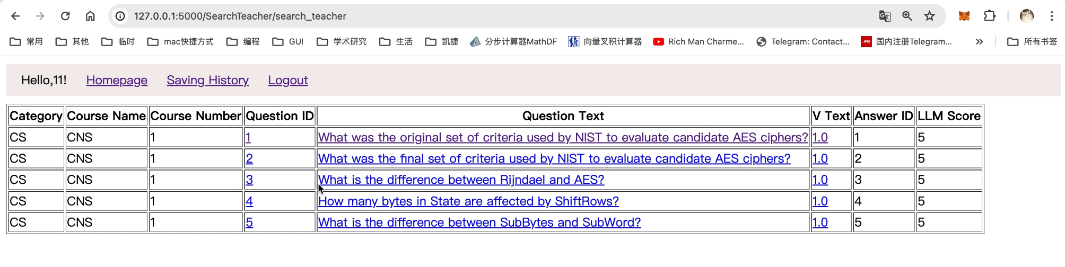
Search Results:
Click the link under “Question ID”, “Question Text” or “V Text” to show the question’s details

Slide 21
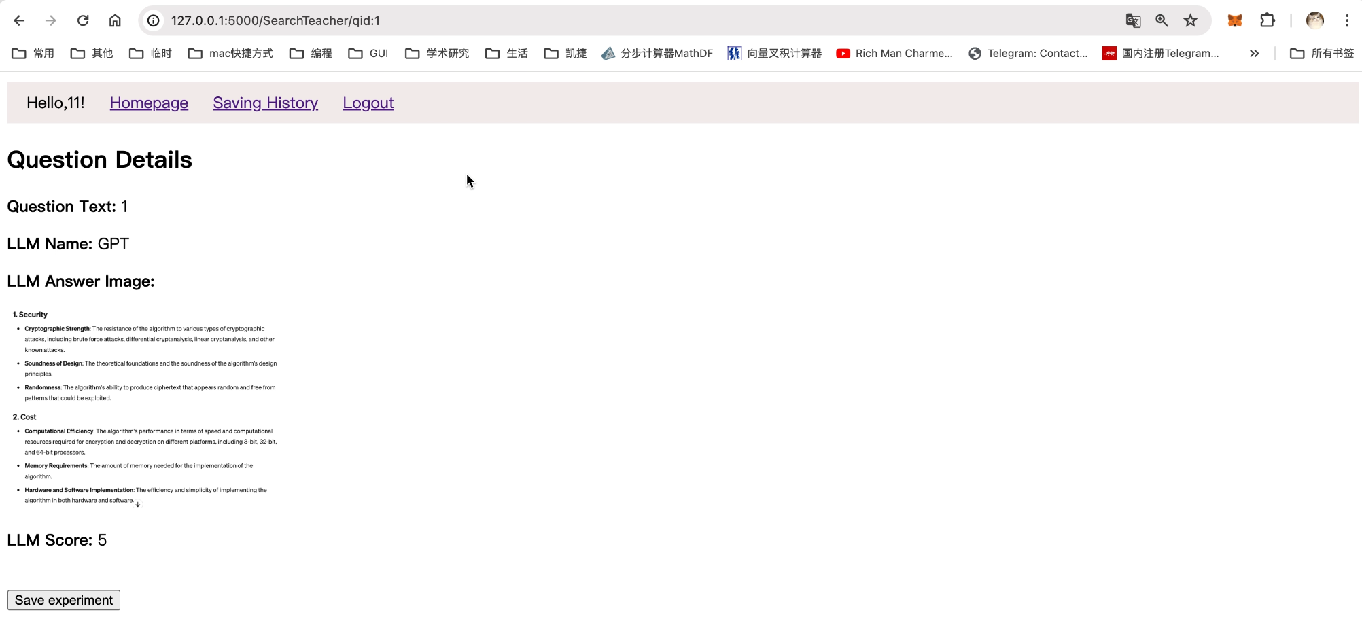
Question Details:

Slide 22
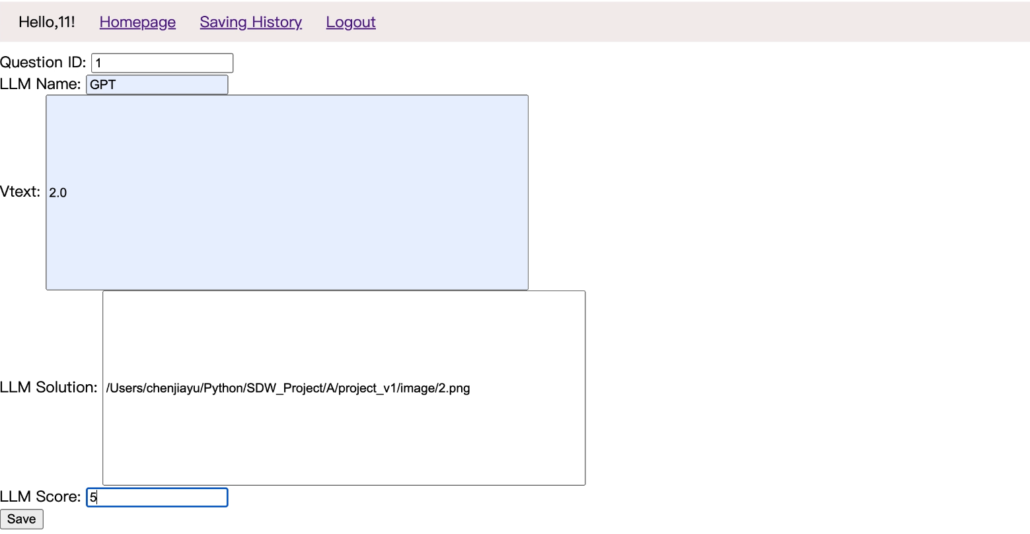
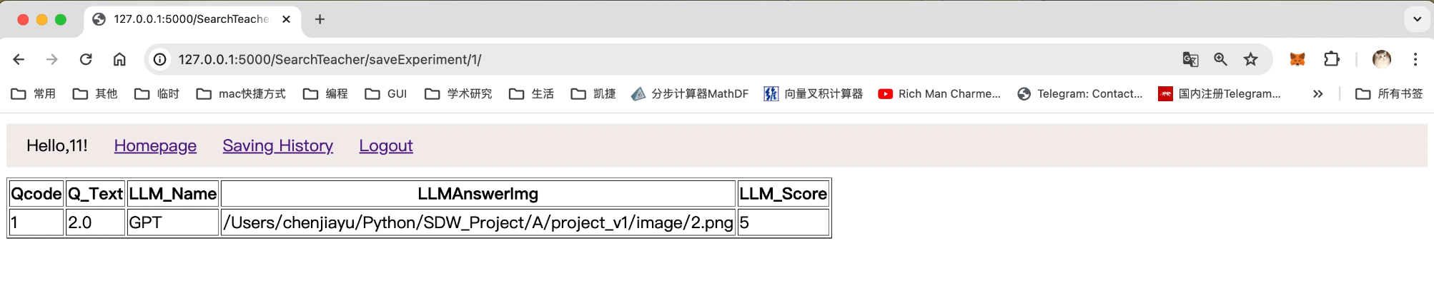
Saving Questions for Experimentation:
With this function, you can upload new problems which are solved by an LLM
Enter a question id here
Input which LLM was used
Input the Vtext
Input the absolute path of the image to the answer of the LLM
Click here to enter “save experimental” interface
Input a suitable score the answer
Click here to save the experiment
If you see the following page, it means you saved your experiment successfully. Then you can click “Saving History” button to see your saving history.
click here to see your saving history

Slide 23
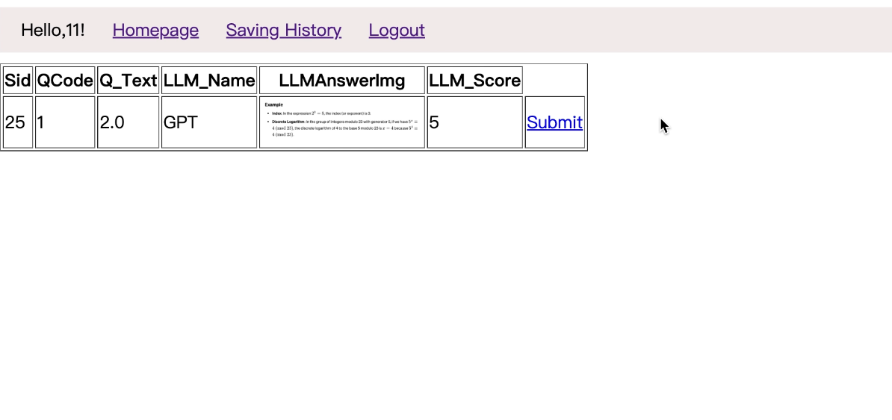
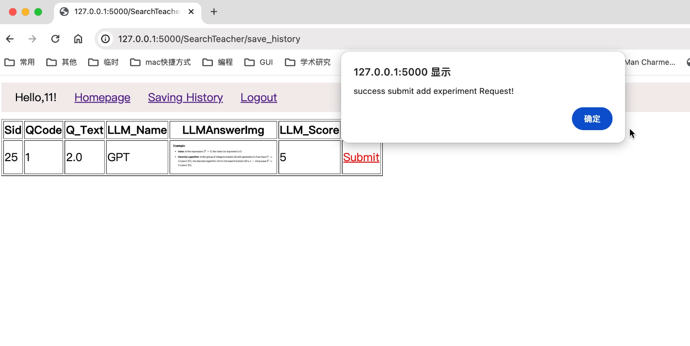
Submit your experiment to be saved:
You can click the “submit” your experimental to have the administrator review it.
If you get this message, it means you submitted it successfully.

Slide 24
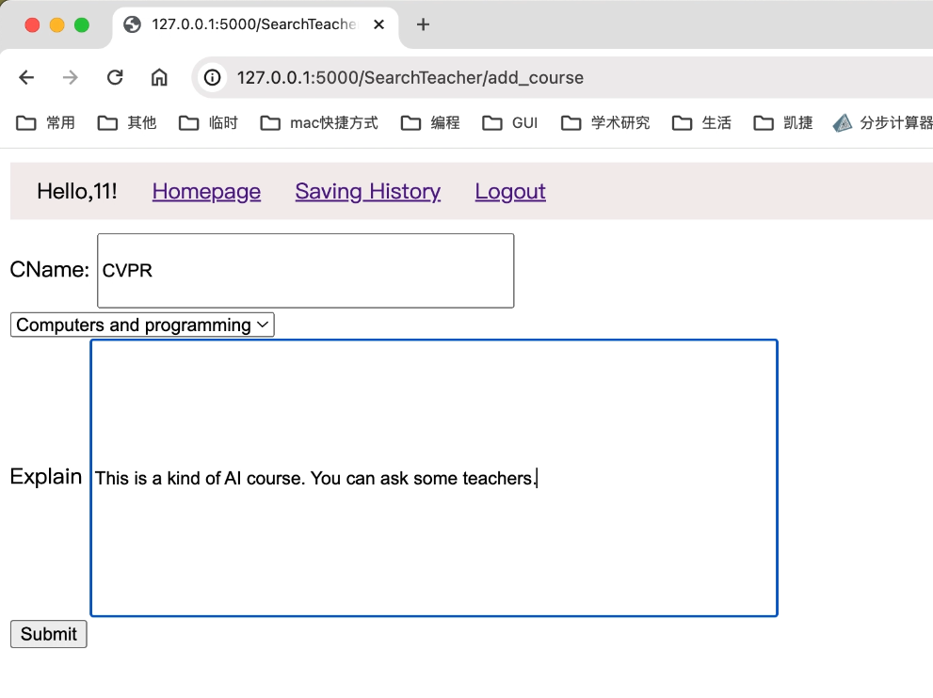
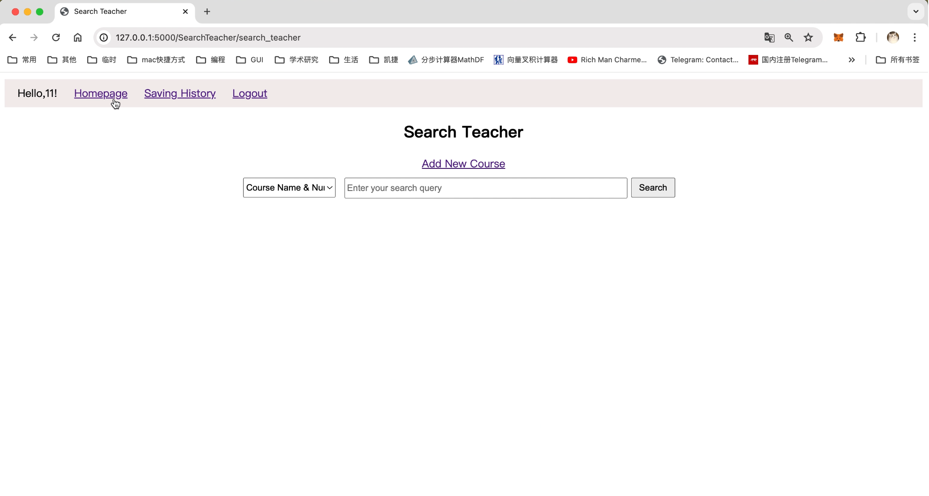
Add new course:
With this function, you can add new courses that can then have questions attached to it within the system.
Click here to enter “add new course”interface
Enter the course name
Select the course category
Input explain
Click here to submit a new course to be added

Slide 25
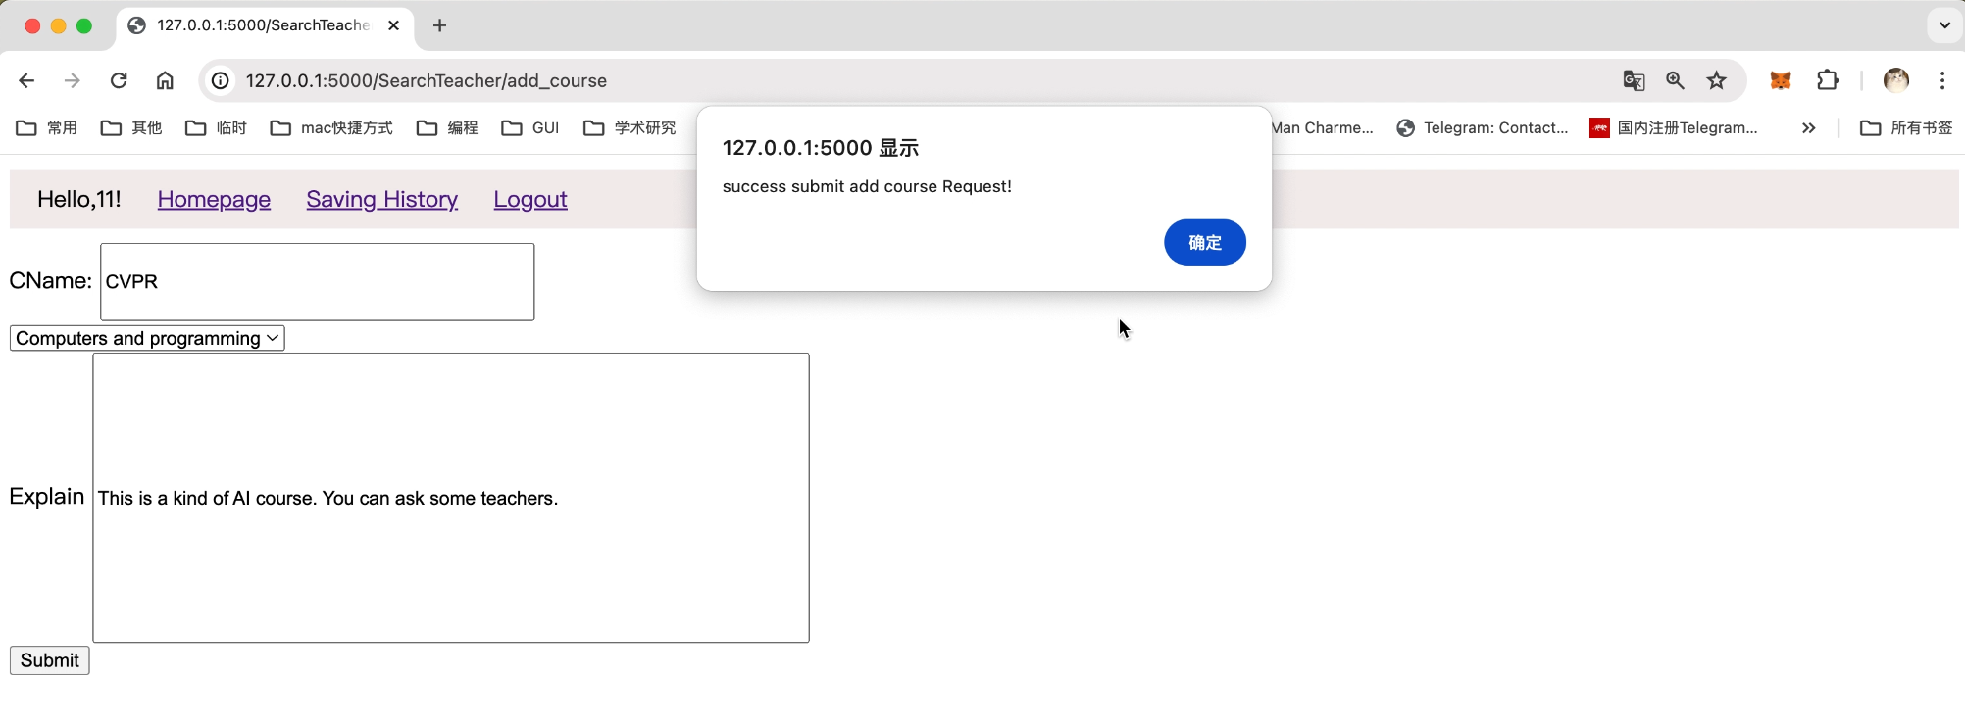
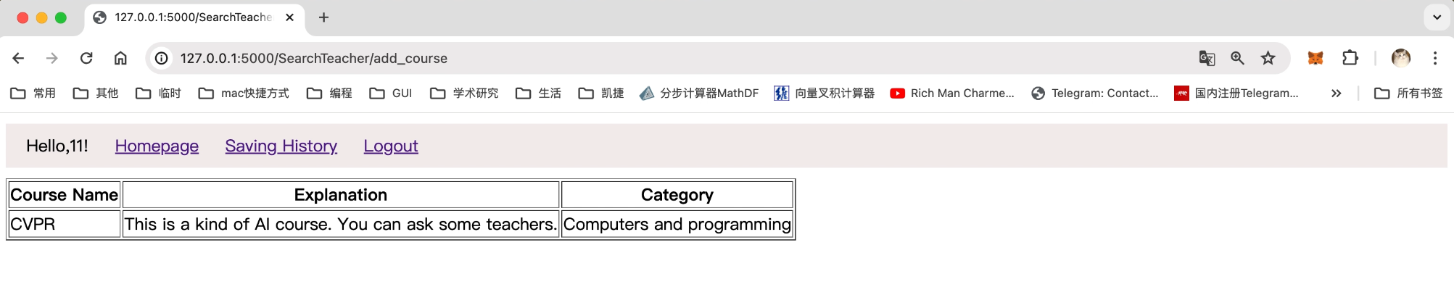
If you get this message, it means you submitted it successfully.
Click here, you will be redirected to the following page
A page that displays the new courses that have been added

Slide 26
Functions of User - Student
As a student, after registering and logging in, there are a number of features that you can access
Navigation Bar
Search Bar
Search Results
Question Details
Saving & Submitting Help Topics

Slide 27
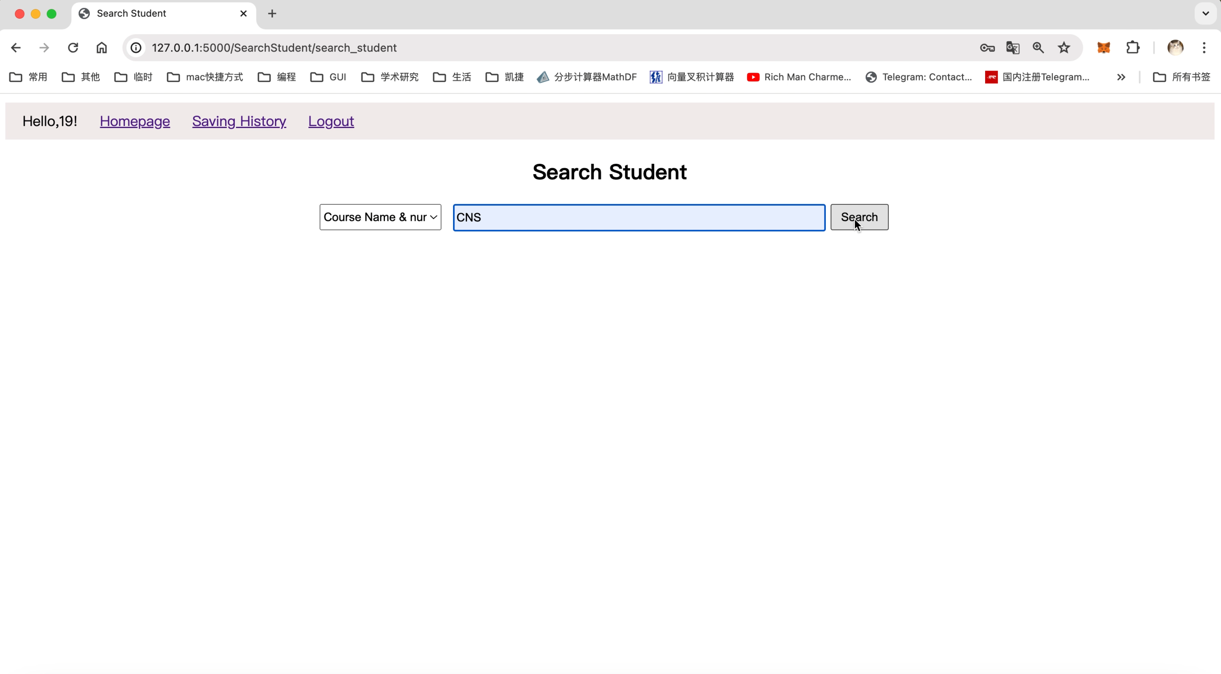
Search Bar:
1.
2.
3.
Choose “Course Name & Topic” or “Category” for different search mode
Input corresponding text for searching
Click “Search” button

Slide 28
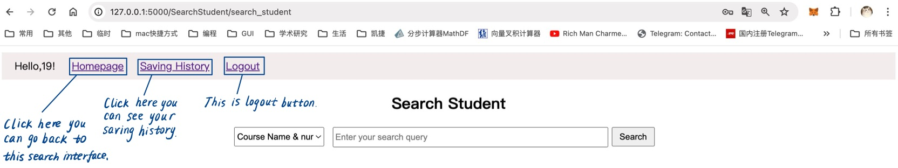
Navigation Bar:

Slide 29
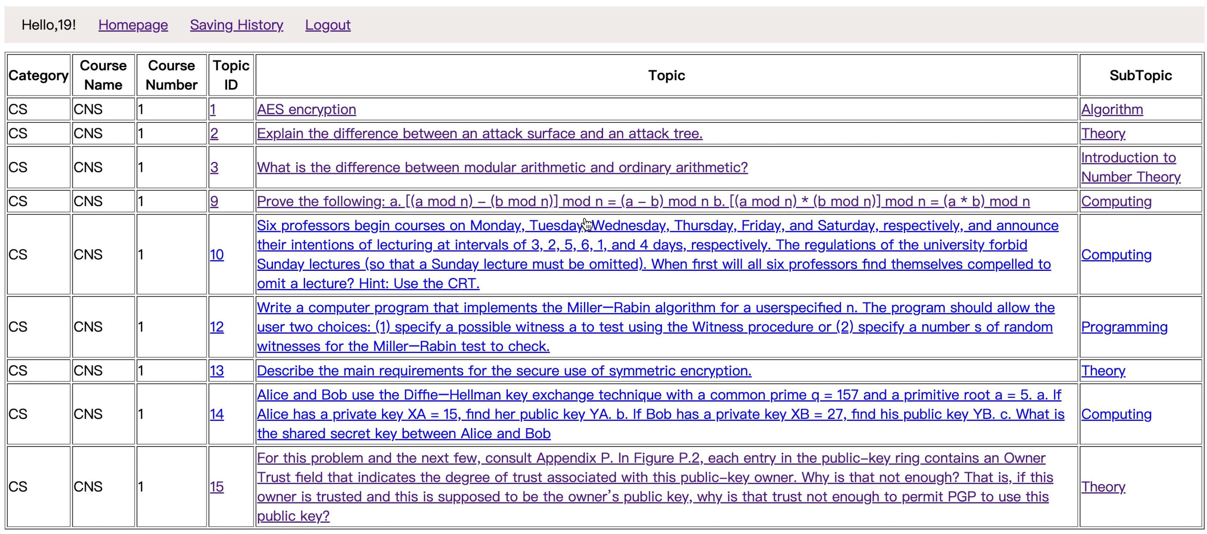
Search Result:
Click the link under topic id, topic or subtopic to show the topic detail

Slide 30
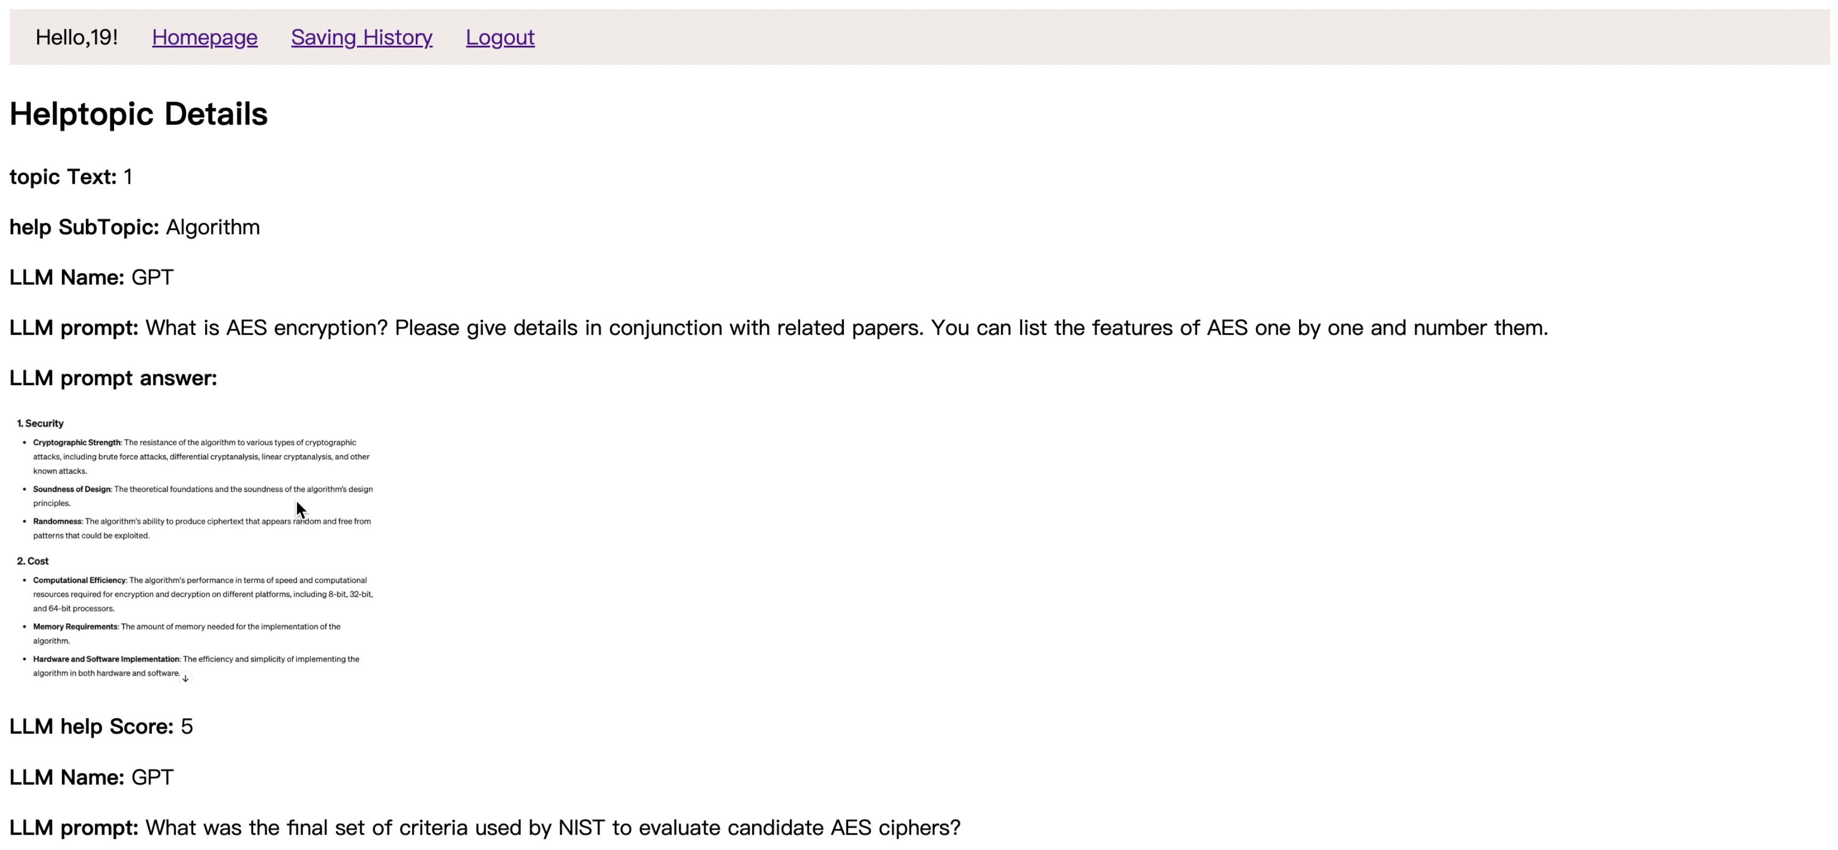
Help topic Details:

Slide 31
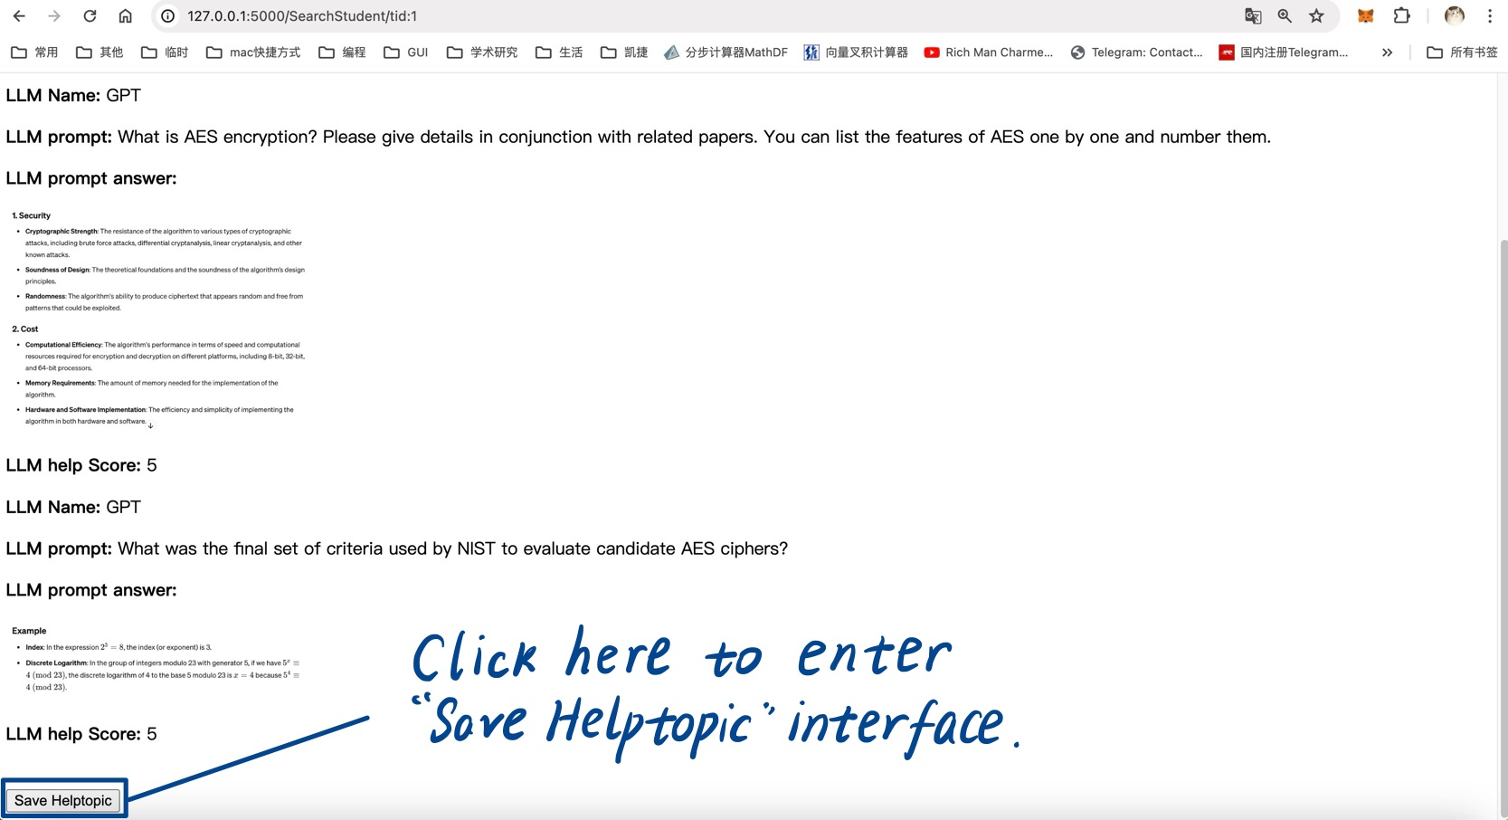
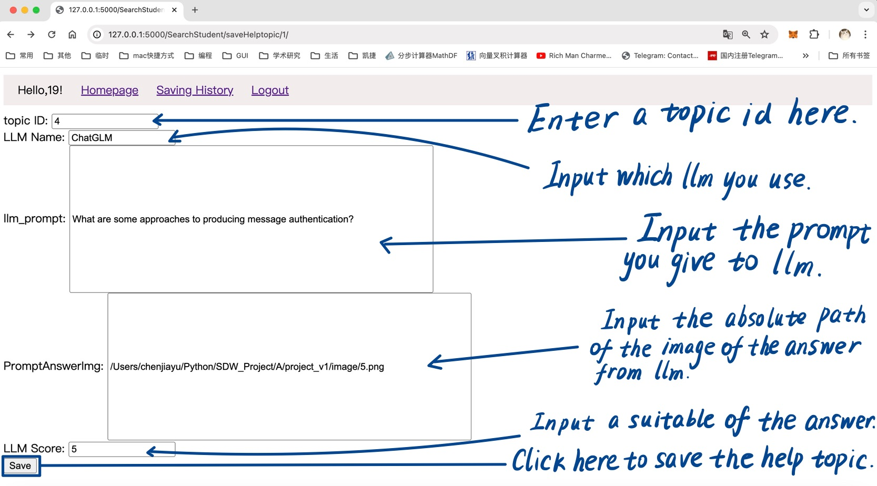
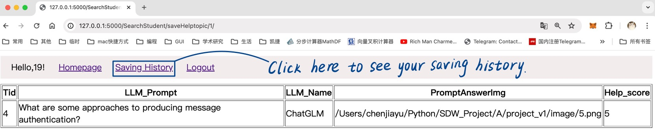
Save Helptopic:
With this function, you can upload new problems which are solved by an LLM and provide the answer (here’s an example).
If you see the following page, it means you saved your help topic successfully. Then you can click “saving history” button to see your saving history.

Slide 32
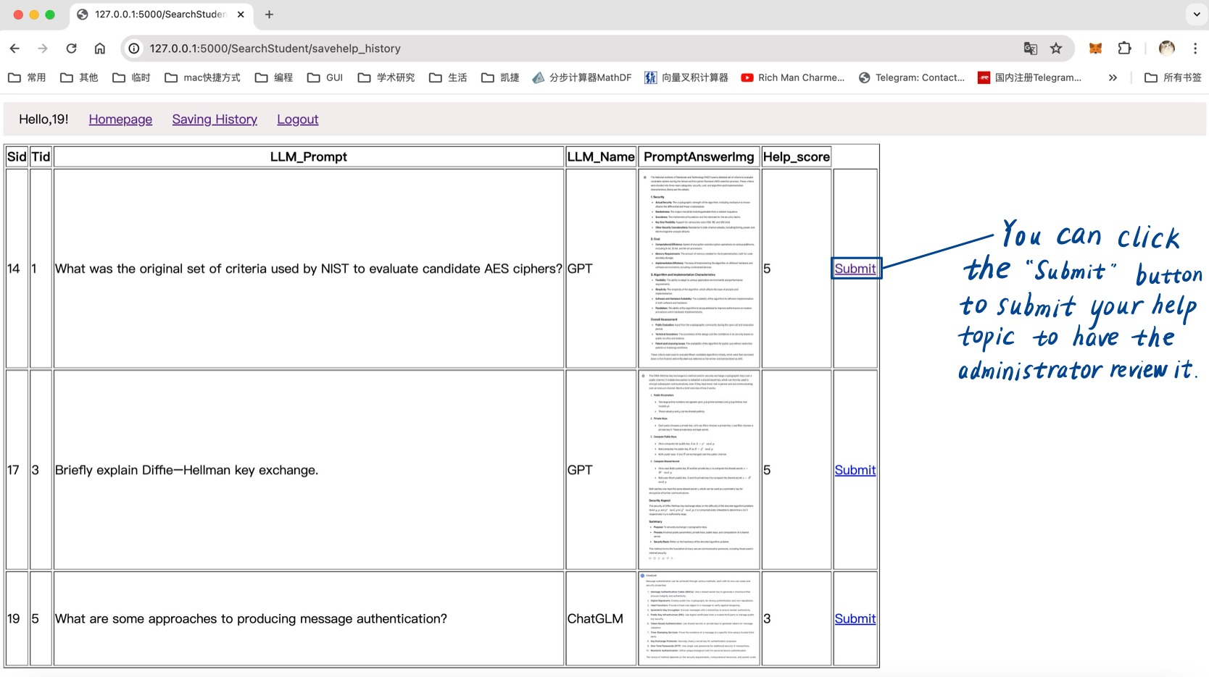
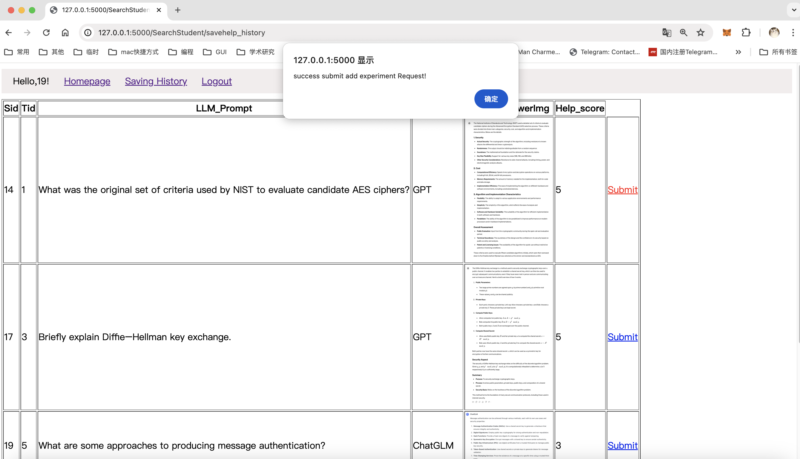
Submit your help topic to be saved:
If you get this message, it means you submitted it successfully.

Slide 33
Functions of User - Admin
As an Admin, after logging in, there are a number of features that you can access
Approving and denying Experiment requests
Approving and denying class addition requests
Approving and denying score changes
Approving and denying new help topics

Slide 34
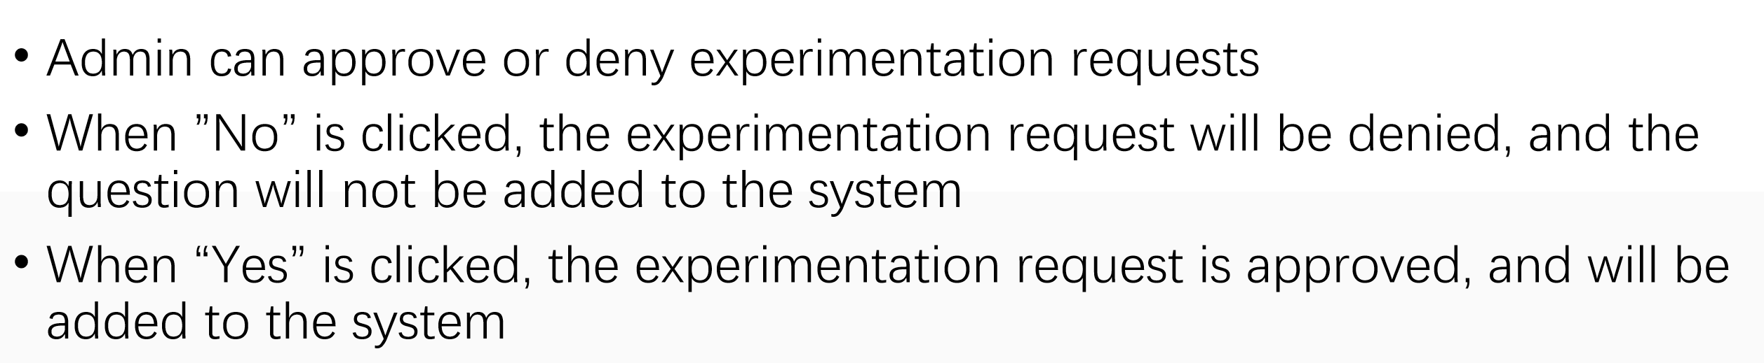
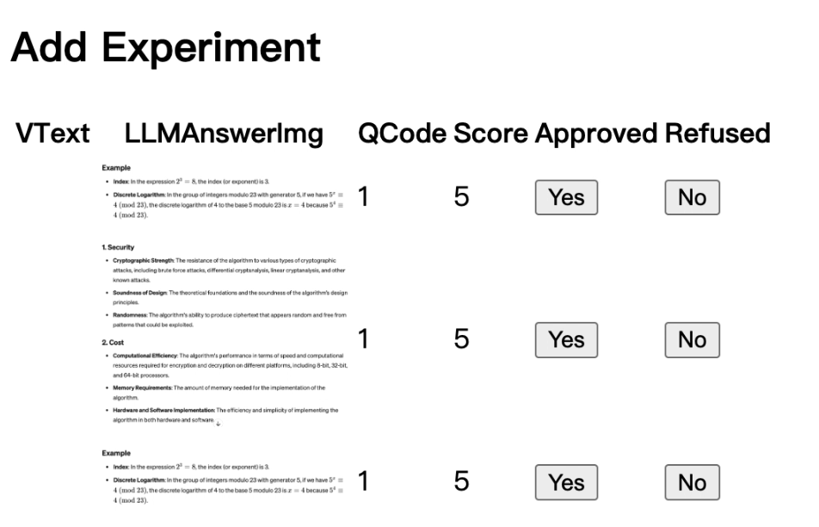
Add Experiment

Slide 35
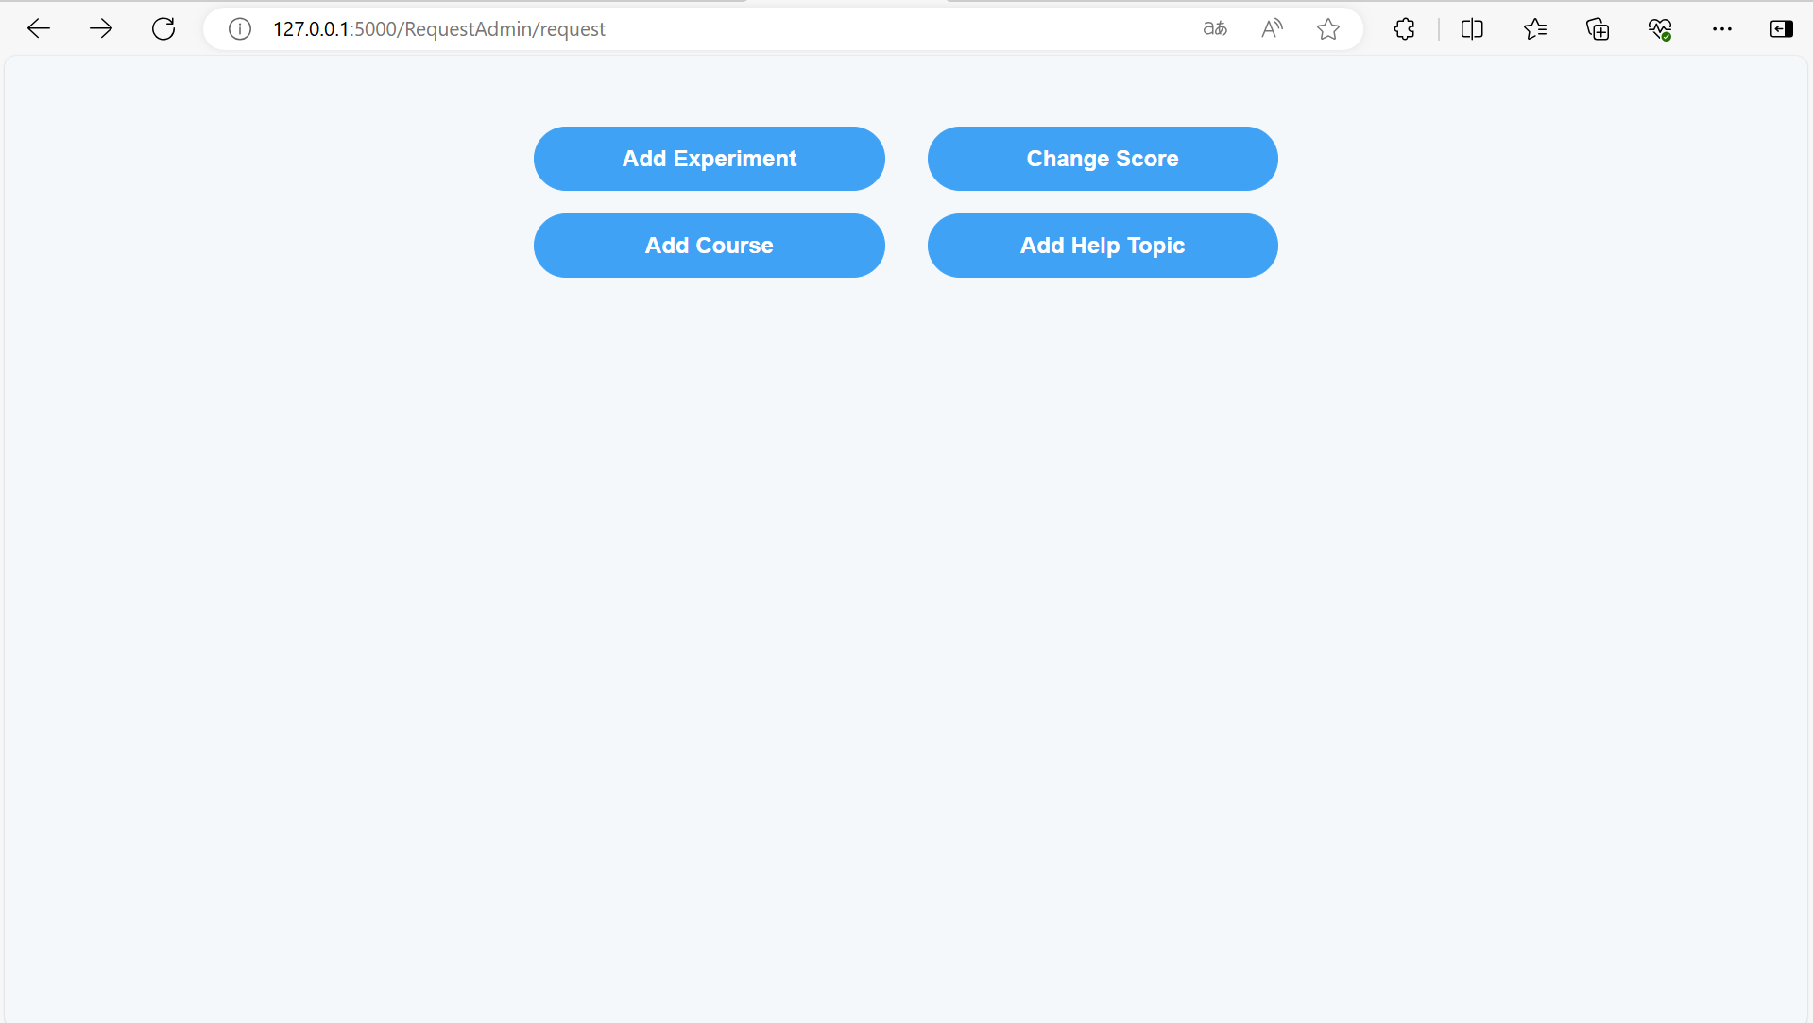
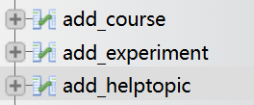

In it
Log in to get this interface
This is its usable function
Each has its own table in the database

Slide 36
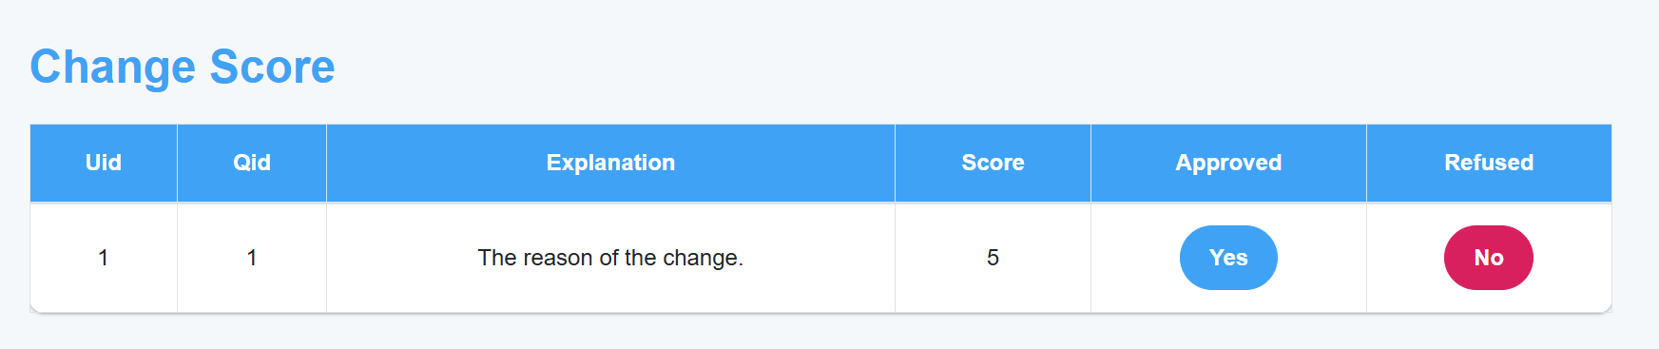
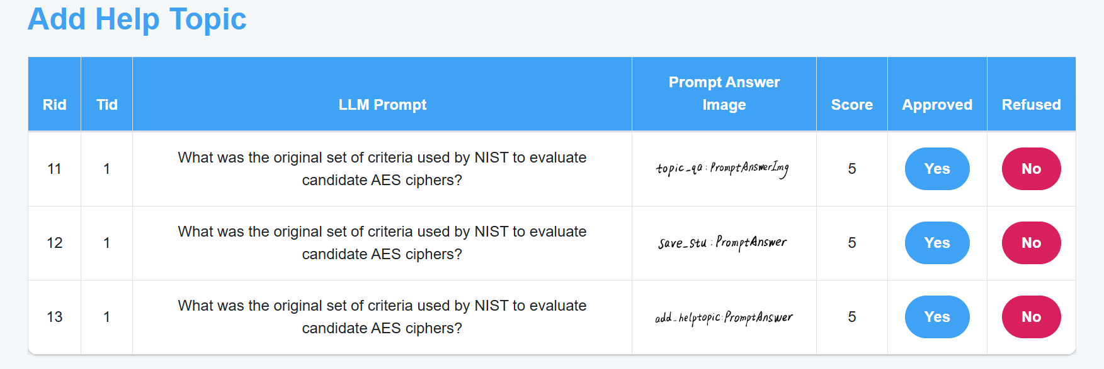
There can change score and add help topic
Clicking yes means adding it to the target table
clicking no means removing it from the request

Slide 37
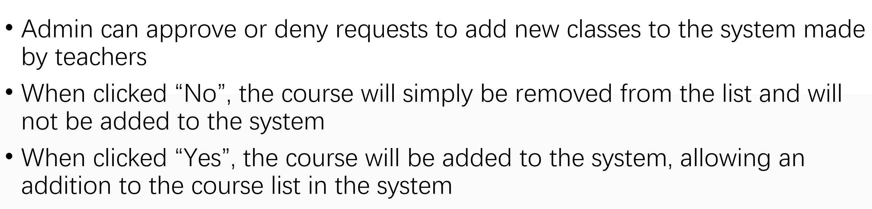
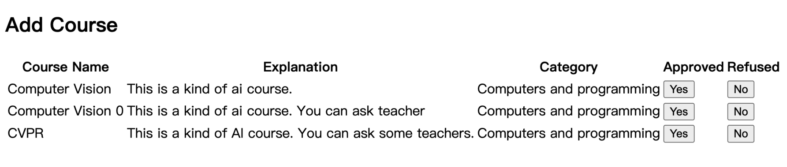
Add Course

Slide 38
Software Testing

Slide 39

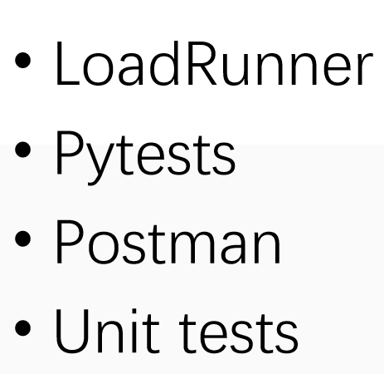



Testing Methods

Slide 40
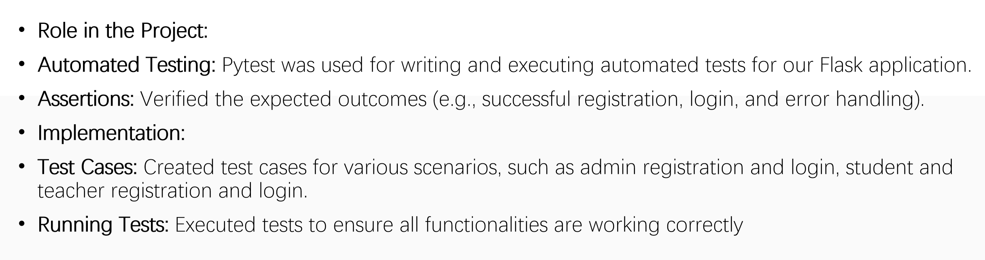
Pytests

Slide 41
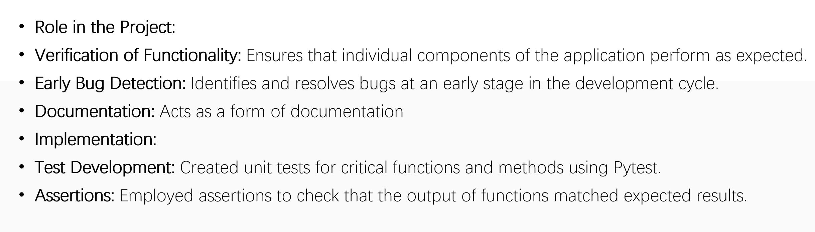
Unit Testing

Slide 42
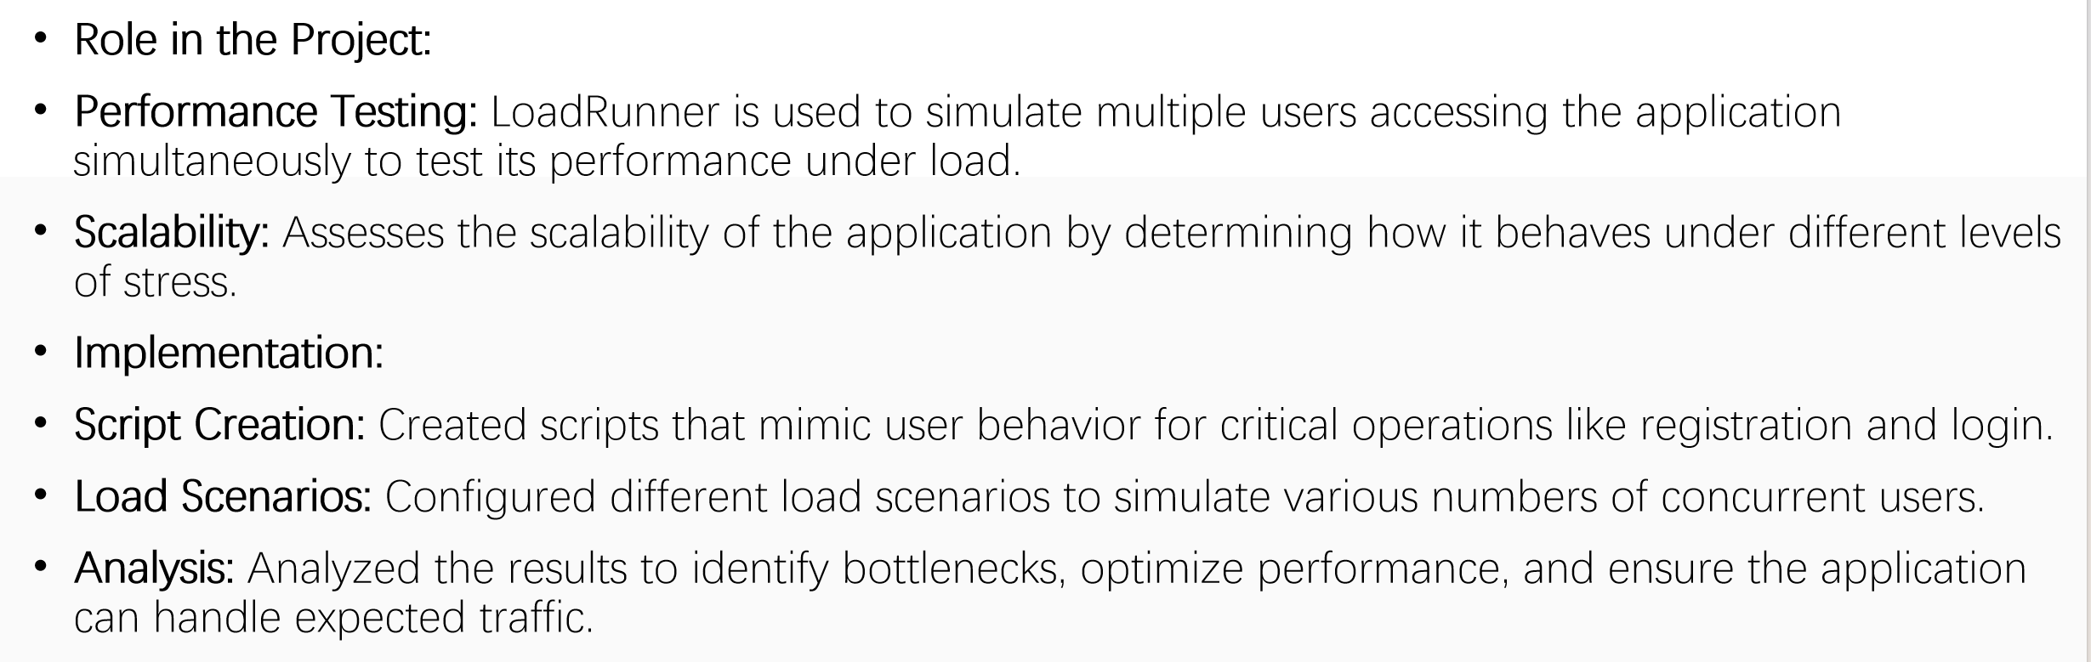
LoadRunner

Slide 43
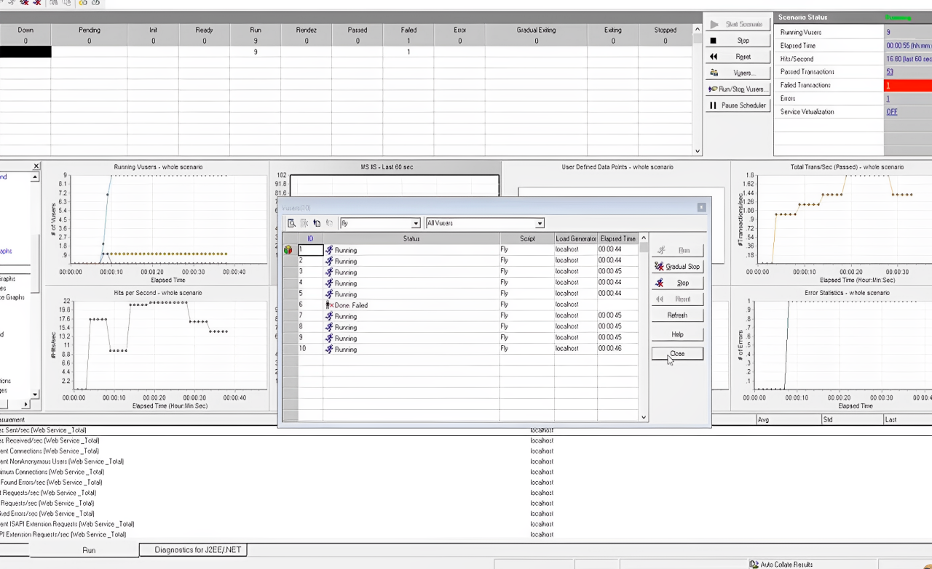
LoadRunner

Slide 44
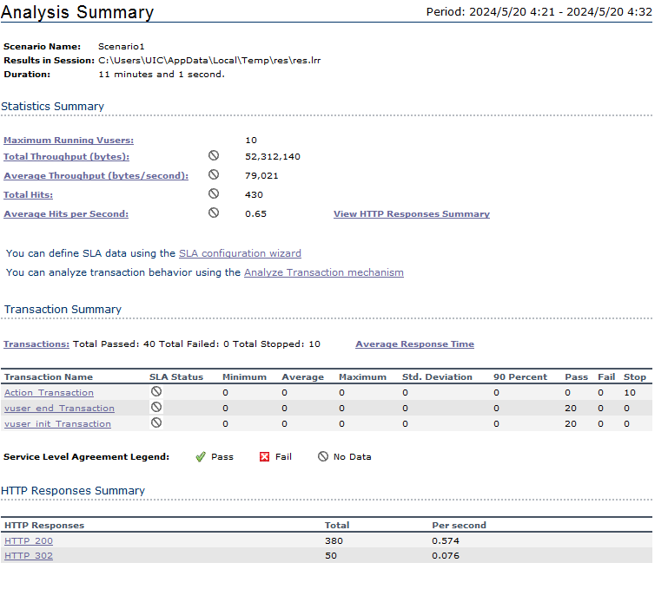
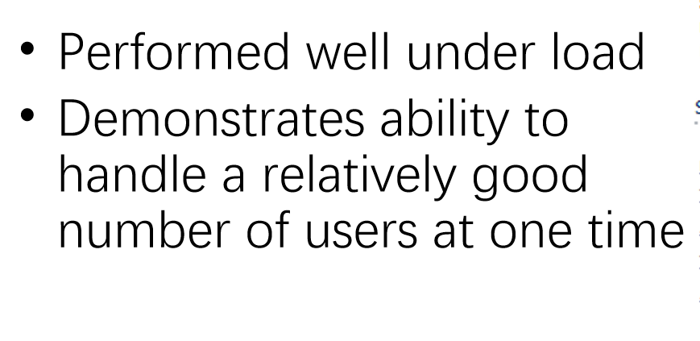
LoadRunner Test Result

Slide 45
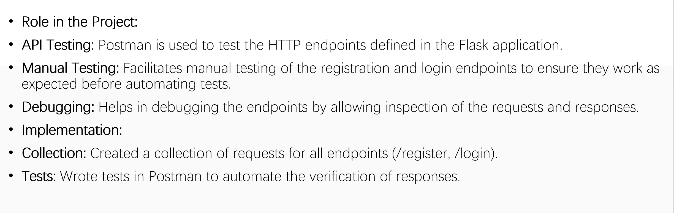
Postman

Slide 46



Postman

Slide 47

Add test data
Adding test data for the testing

Slide 48
LoadRunner Test Result
Very Well ☺

